Slide 1



Slide 2

Mr.Shelby
Python Project (Chabot for Ignite)
Batch-28_B4
Ishan Pranajal Neeraj Faisal Gerard

Slide 3
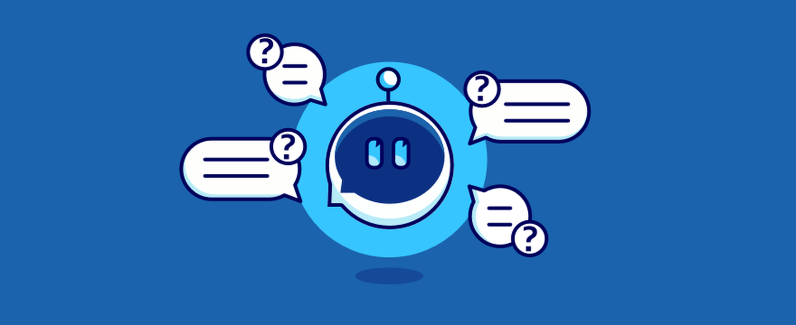
What Is Chabot
A Chabot is an AI-based software designed to interact with humans in their natural languages. These Chabot's are usually converse via auditory or textual methods, and they can effortlessly mimic human languages to communicate with human beings in a human-like manner.
The first Chabot ever was developed by MIT professor Joseph Weizenbaum in the 1960s. It was called ELIZA.
Chabot's are used a lot in customer interaction, marketing on social network sites and instantly messaging the client. There are two basic types of Chabot models based on how they are built; Retrieval based and Generative based models.

Slide 4
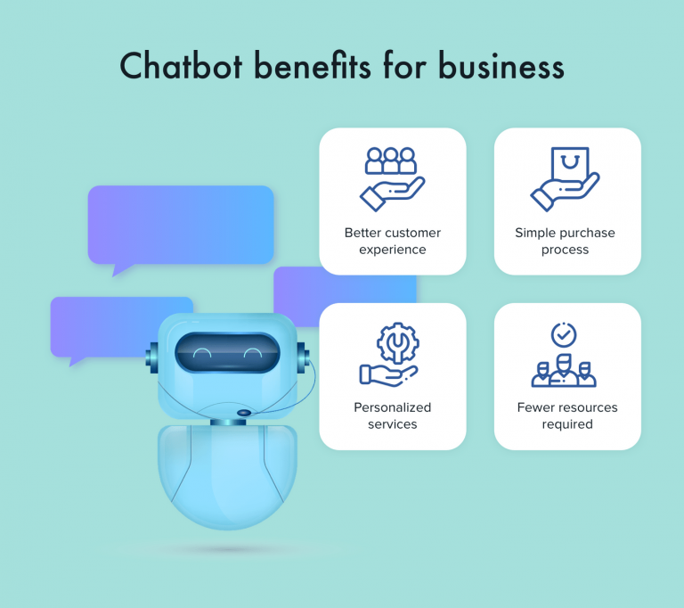
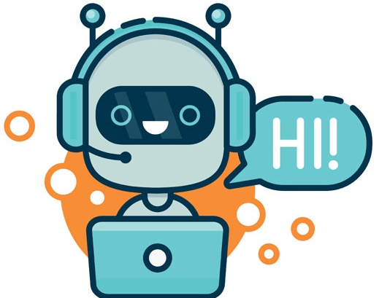
Js
CSS
Flask
NLTK
HTML
Numpy
Python
Tensor Flow
It is estimated that by end of 2021, Chabots will be handling 85 percent of customer-service interactions;

Slide 5


